Slide 1
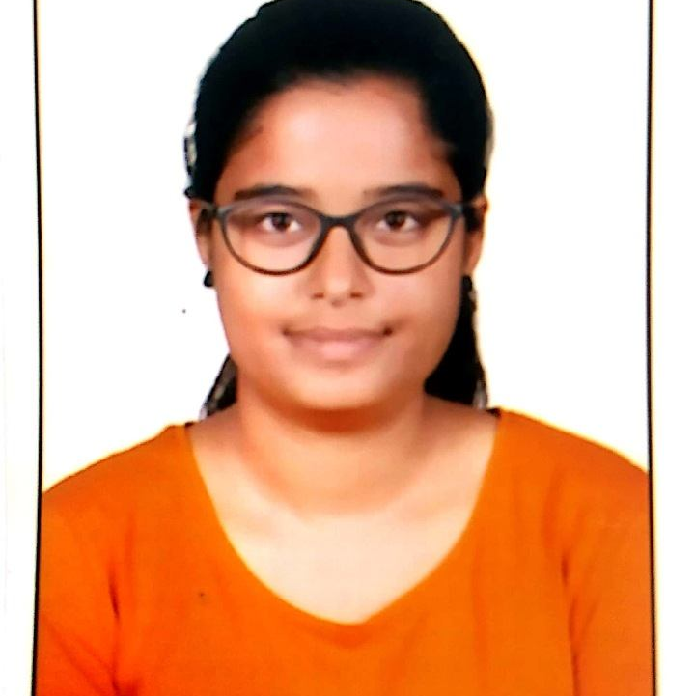

Pooja Anil Jadhav
Analyst/Software Engineer
Bachelor of Technology
Civil Engineering :
2016 - 2019
Skills C#
ADO. NET
ASP. NET Framework
ASP. NET Core MVC
Bootstrap
Database
SQL database – MySQL
Web Technologies
HTML5
CSS3
Add-ons
GitHub
Postman
Swagger
Tools
Visual Studio 2019
Visual Studio code
Additional Details
Leadership
Quick Learner
Team management
Excellent Communication Skills
Mumbai
POOJA-ANIL.JADHAV@CAPGEMINI.COM
+91 9423224127/8208798736
A4
Software Engineer who is Strong in design and integration with intuitive problem-solving skills. Passionate about implementing and launching new projects.
Ready to learn new technologies and implement them to further improve my knowledge.
Ability to learn processes and systems quickly.
Eager to work in a team of dedicated people and serve a key role in the enhancement and development of the project.
Hotel Booking System
Developed an web application called Hotel Booking System along with JWT authentication, Swagger and Rest API using Asp. Net Core MVC, Microsoft SQL and Bootstrap used for user interface.
AZ – 900 Microsoft Azure Fundamentals Certification
Learning AZ- 900 Microsoft Azure Fundamentals.

